Slide 1
WEBINAR SESI PEMANTAPAN ILMU SIRI 3/2021
Santai Bersama UCC "Application for Copyright & Trademark : Step by Step"

Slide 2
WHAT IS COPYRIGHT?
Copyright is the exclusive right given by law for a determinable time period to the author of the work to control the use of the work in Malaysia.

Slide 3
WHAT WORKS GET COPYRIGHT PROTECTION?
The following works are protected:- (i) Literary works; (ii) Musical works; (iii) Artistic works; (iv) Films; (v) Sounds recordings; (vi) Broadcasts; and (vii) Derivative works.

Slide 4
CRITERIA FOR PROTECTION
A work that is eligible is protected automatically upon fulfillment of the following conditions :
Sufficient effort has been expected to make the work original in character
The work has been written down, recorded or reduced to a material form
The author is qualified person or the work is made in Malaysia or the work is first published in Malaysia

Slide 5
Copyright Is NOT
MATEHEMATIC CONCEPT
IDEA
PROCEDURE
METHOD OF OPERATION

Slide 6
WHAT ARE THE EXCLUSIVE RIGHTS OF THE OWNER?
The performance, showing or playing to the public
The distribution of copies to the public by sale or other transfer of ownership
The commercial rental to the public
The communication to the public
The reproduction in any material form (including making photocopies, recording and others)

Slide 7
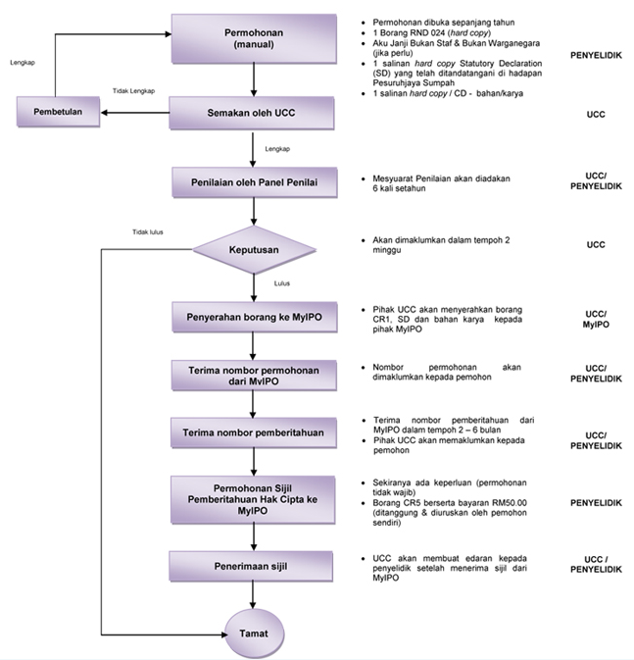
COPYRIGHT FLOWCHART

Slide 8
HOW TO APPLY?
BORANG PERMOHONAN COPYRIGHT (RND0024)
RND0024(ONLINE).pdf
MyIPO FORM (CR-1)
CR-1-2018.pdf
STATUTORY DECLARATION (AKUAN SUMPAH)
STATUTORY DECLARATION FOR COPYRIGHT.docx
COPYRIGHT WORK
AKU JANJI PELAJAR
TEMPLET PEMBENTANGAN

Slide 9
STATUTORY DECLARATION (SD) FOR COPYRIGHT
Need to formalize the copyright work through SD with a Commissioner for Oaths
The form consists of two parts :
Part I: The main part of SD form (RM4)
Part II (RM2 each Exhibit)
Exhibit 1 - Personal details of the Author/co-inventors
Exhibit 2 – Title of the Work & copyright work

Slide 10
FORM FEES (CR-1)
ITEM | DESCRIPTION | FEE
 |  | Manual (RM) | Electronics (RM)
Notification of works
a. | Notification of copyright | 15 | 15
b. | Deposit of the work :
 | Document 1-25 pages 26-50 pages Every subsequent additional 50 pages | 10 20 10 | - - -
 | Compact Disc Read –Only Memory (CD ROM) – per CD ROM | 30 | -
C. | Borang CR-5 (Request For Certificate Of The Notification Of Copyright) | 50 | 50
 | TOTAL = a+b+c

Slide 11
WHAT IS TRADE MARK?
Trade mark is a sign which distinguishes the goods and services of one trader from those of another.
A mark includes words, logos, pictures, names, letters, numbers or a combination of these

Slide 12
FUNCTIONS OF TRADE MARK
ORIGIN
CHOICE
A trade mark assists consumers to choose goods and services with ease
ECONOMIC
Recognized trade mark is a valuable asset. Trade marks may be licensed or franchised.
MARKETING
QUALITY
Trade mark play a significant role in promoting. It’s common for consumers to make purchases based on continuous effect of advertising.
A trade mark helps to identify the source and those linked for the products and services trade in the market.
Consumers define a certain trade mark for its known quality.

Slide 13
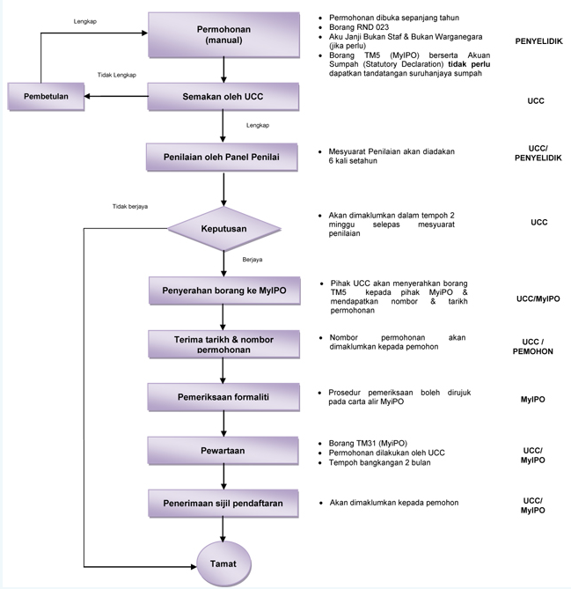
TRADEMARK FLOWCHART

Slide 14
HOW TO APPLY?
TRADEMARK APPLICATION FORM (RND0023)
RND0023(ONLINE).pdf
MyIPO FORM (TMA2)
TMA2 .docx

Slide 15
DURATION OF PROTECTIONS
Trademark
10 years
Copyright
50 years after his death

Slide 16
THANK YOU
Website :
http://ucc.utem.edu.my/ms/
https://ucc.utem.edu.my/ms/borang-ucc/category/16-copyright.html

