Slide 1
How to Find the Right Scopus Indexed Journals?
Dr. Samer Ali Al-shami

Slide 2
Presentation Outline
Discuss about Predatory Journals and how to avoid them
Discuss about Blacklisted Scopus Journals and how to avoid the potential blacklisted and predatory journals
Discuss on How to find and Publish Article Scopus Journal

Slide 3
Predatory Journal
Beall describe predatory publishers as outlets “which publish counterfeit journals to exploit the open-access model in which the author pays” and publishers that were “dishonest and lack transparency
https://beallslist.net/
Beallslist

Slide 4
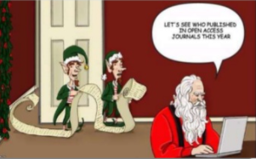
WHAT ARE THE PREDATORY JOURNALS ?
Predatory
Open access
Journals actively ask for manuscripts
Have no peer review
Huge publication Charge

Slide 5
WHERE ARE THE PREDATORY PUBLISHERS ?
India, South Asia, Nigeria, UK, Ontario, Australia, US
Expatriates in Western countries catering to their home countries
More academic credit for “International” journals
American Journal of _________ .
https://beallslist.net/contact/
https://beallslist.net/wp-content/uploads/2019/12/criteria-2015.pdf

Slide 6
Blacklisted Journals by Scopus
Blacklisted Scopus
Publishing out of the Scope
Plagiarism and Publishing in huge Quantity
Impact Factor deterioration
Quality of reviewing and formatting

Slide 7
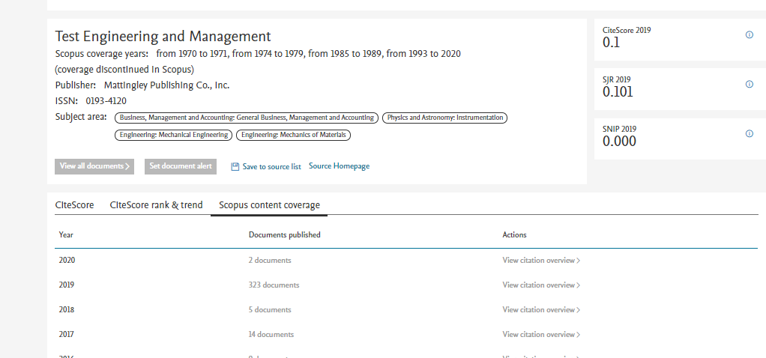
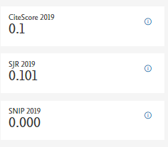
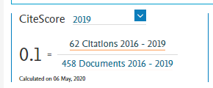
Example Test Engineering
published in 2019 more (323 articles) than citation

Slide 8
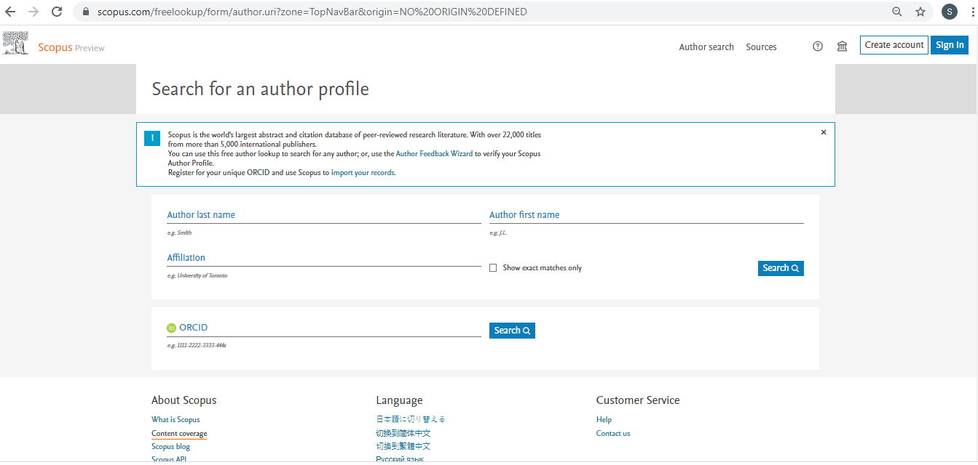
Check Blacklisted and Discontinued Journals
Login Scopus
Click content Coverage

Slide 9
Check Blacklisted and Discontinued Journals
Download the list of discontinued journal

Slide 10
How to publish article in Scopus Journal
Manuscript
High Quality
Q1/Q2
ISI 1>
Appropriate Journal Q3, Q4
Standard
Q4

Slide 11
High quality
Easily rewarded
Easily recognition
Self-skills development
Free of charge
Take a long time
Need skills
Need commitment
Need collaboration

Slide 12
How to publish in High quality Journals?
Reputation
Scope
Indexed
Editorial standards
Accept Rate
Cost
Impact Factor

Slide 13
Strategy to publish in High Impact
Select journal that related to your topic citation
Theory Gaps proven
Method sound and quality
Knowledge Novelty and Gaps bridging
Writing standard and philosophy

Slide 14
Acceptable Paper Q3 Q4
Is a piece of paper that addresses literature gaps from specific country or industry and conducted with good methods
Paper with descriptive results
Manuscript with good quality of writing and relevant references from 4000 to 5000 words
Good layout with readable language that cope with journal formatting and standards

Slide 15
How to get a good journal for language?
Click Scimago
https://www.scimagojr.com/journalrank.php
click all subject and select social science
Customize the region if you want to Asian
Select type journal
Education Journals
https://www.scimagojr.com/journalsearch.php?q=education&page=2&total_size=1278
51 - 100 of 1278

Slide 16
